Slide 1
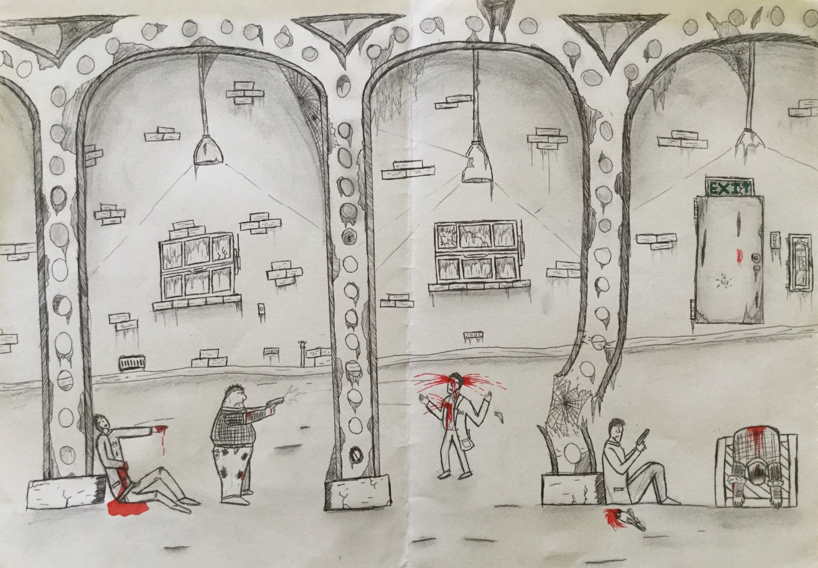
Mafia
Insert image of your own artwork
I chose mafia because they were most famous in the 50’s and 60’s which is my favourite time period. The colour contrast was also a reason why I decided to choose mafia as they were involved in a lot of bloody situations.
Julian Price

Slide 2
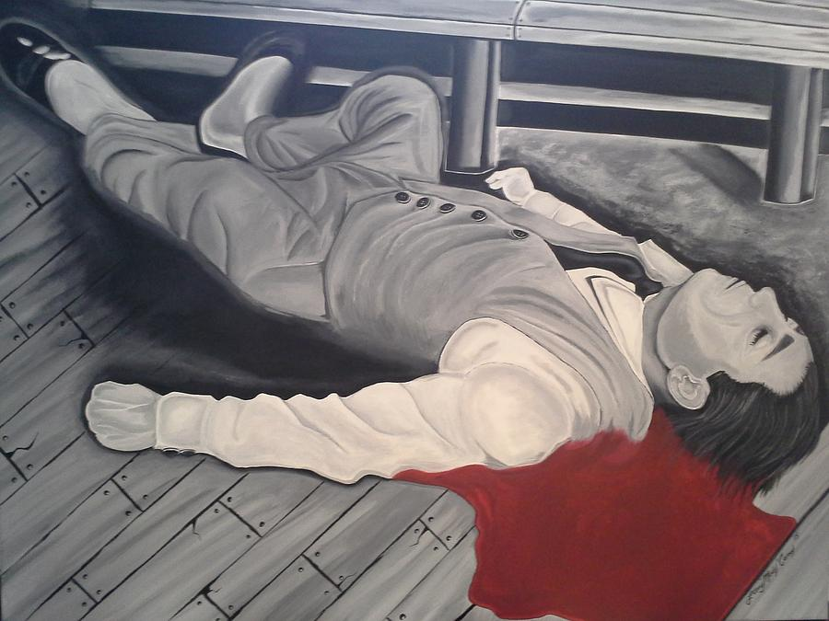
Larry Munkey Conroy
Machine gun Jack
Painting, Acrylic on canvas
March 1st 2016
48.000 x 36.000 x 1.500 inches
Like my artworks this image uses colour only sparingly and only on blood to emphasise the impact of the blood. The image is of a man who is wounded and possibly dead on the floor. The image is simple but the colour technique used makes the painting more interesting because of the emphasis on the blood and the contrast. There are no signs or symbols in this painting however it does not effect the painting at all. I like the image because of the colour contrast and detail that has gone into the overall image.

Slide 3
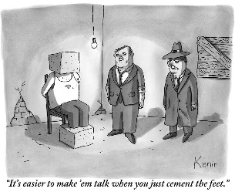
Zachary Kanin
One Mafioso to another
Drawing
July 25th 2011
Size not shown
This relates to my theme because it has somewhat detailed characters and a detailed background in a grey scale with use o shading in some areas. The image is two Mafioso's that have cemented another Mafioso's feet and head. The artwork uses simple techniques of grey scaling and shading to make the image have a darker tone that isn’t to say that art would have a light tone if the image was in colour but the grey scale emphasises the tone and aids it as it is conveyed to the audience. Shading was used to create a sense of darkness and outlines the light coming off of the bulb. This creates a stereotypical setting for a Mafioso to commit a crime. There are no use of symbols in this artwork. I like the simplicity shading and cartoon characteristics that were given to the characters.

Slide 4
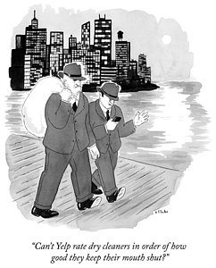
Emily Flake
Two mafia guys walking down the street
Drawing
December 8th, 2014
Unknown
Insert image
This Artwork relates to my theme as it is two Mafioso's walking on what appears to be a pier and my theme is mafia . The image is of two Mafioso's walking on a pier one with a sack which is presumed to have a body in it. The background is a simple shadow of a city. The basic colour pallet emphasises the time period (40s-60s) this coupled with the shadowing used on the water to show a reflection make a fantastic scene for a stereotypical mafia set. There were no signs or symbols used. I liked the way this artwork depicted the world of mafia with a classic scene of the kidnapping of a “snitch.”

Slide 5
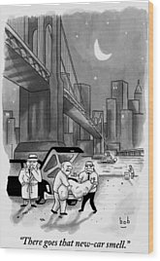
Bob Eckstein
A couple of mafia employees take a body bag
Drawing
February 13th, 2012
Unknown
Insert image
This relates to my theme because it is a mafia setting which is shown through the Mafioso's disposing of a body from the boot of a car under the Brooklyn bridge. They are about to throw the body into the river and the setting is at night. The black and white theme combined with the fantastic shadowing mean that set a mood that is of eerie descent. The Brooklyn bridge is a symbol in this art that stereo types the mafias American branches. As they were active in this area of New York. I like this image because it creates an enjoyable scene to look at.

Slide 6
http://fineartamerica.com/art/drawings/mafia

